Slide 1

Ranging RFID tags with ultrasound
Riccardo Carotenuto, Member, IEEE, Massimo Merenda, Demetrio Iero and Francesco G. Della Corte, Senior Member, IEEE
Samarth S Kulkarni
1DS16CS096
Department of Computer Science & Engineering, DSCE

Slide 2
Introduction
Objectives :
Introduction of localization capability to RFID tags.
Determine the possible solutions to achieve the implementation.
Consider the main limitations and ways to bypass these limitations.
Making the system compatible with the existing RFID systems.
Exploring the possibility of 3D localization and reading fine movements.

Slide 3
Introduction
The method to determine location of a RFID tag is to measure the distance between the tag, reference points and the sensor.
For 3D localization, at least 3 or more reference data is required.
Location of RFID tags can be determined by RF signals, sound waves, magnetic fields or optical signals.
Various techniques can be used to achieve this, one of the methods is based on the Received Signal Strength Indicator but it is not efficient and accurate as it is only accurate in order of meters.
Ultrasonic waves are more commonly used and has a much higher accuracy. The acoustic systems can use Time of Arrival (ToA), Time Difference of Arrival (TDoA) or Angle of Arrival (AoA) to locate the tag in order of centimeters. The only drawback is that it is a very power intensive method.

Slide 4
Introduction
Wireless Identification Sensing Platform (WISP) uses custom passive tag with acoustic tone detector to bypass the power limitation.
This system uses cross-correlation algorithm for superior accuracy level. The downside being that the algorithm is inefficient with power.
By offloading the computation to an external CPU we can get the best of both techniques.

Slide 5
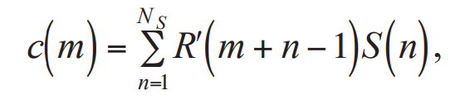
Motivation
Cross-correlation has superior accuracy and also good acoustical noise immunity.
The signals are sampled and converted from analog to digital
Cross-correlation array is given by
.
m = (1, 2… N_{R}+N_{s}-1) is the displacement or lag.
R’ is the zero padded R, which means that N_{s}-1 zeros were added at the beginning and the end of R before cross-correlating.
The cross-correlation peak lag is proportional to the Time-of-Flight (ToF) and to the distance between ultrasound emitter and receiver by assuming the known sound of speed.

Slide 6
Ranging Technique and System Architecture
Fixed receiving time windows are allocated.
A RFID reader at any given instant can interrogate any one of the available sensors.
The sensors send the sampled chirp along with the EPC (identity) to the reader. This is sent to the external CPU which reconstructs the captured chirp and cross-correlates it to the existing chirp which gives us the delay and thus the range is calculated.
The RFID protocol allows the reader to interrogate the RFID tags in its neighborhood only

Slide 7
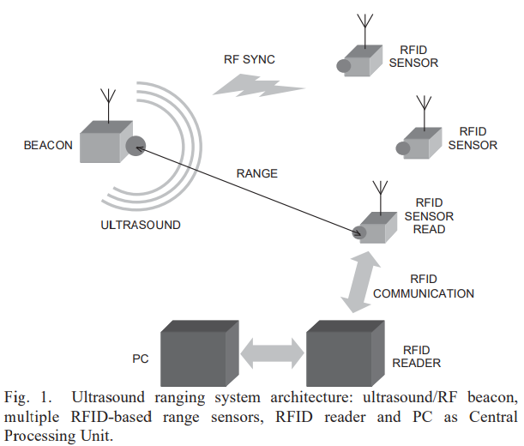
Ranging Technique and System Architecture

Slide 8
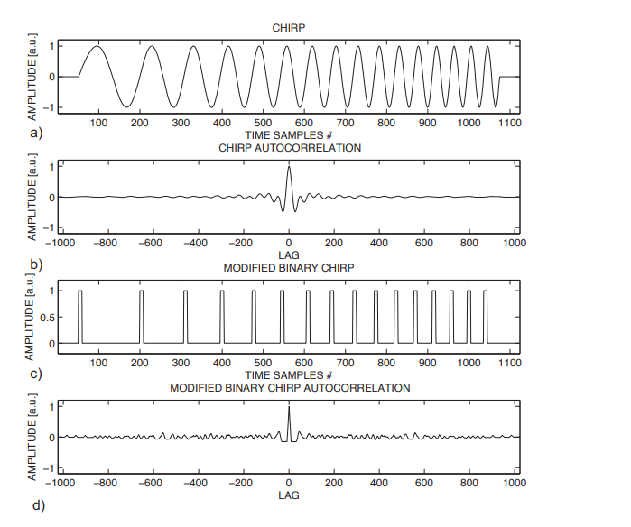
Ranging Technique and System Architecture

Slide 9
Ranging Technique and System Architecture
In brief, the ultrasound travels from the emitter to the sensor’s microphone where a suitable onboard circuit amplifies, filters and digitally squares the impinging ultrasonic signal. As a result, at the end of this chain, the impinging ultrasonic signal is converted into a sort of binary PWM signal, the modified binary signal (MBS), which saves bandwidth and energy when transmitted. A code running in the processing unit “restores” the PWM-like binary signal from the sequences of transition times received, and computes the cross-correlation with a previously stored copy of the emitted chirp.

Slide 10
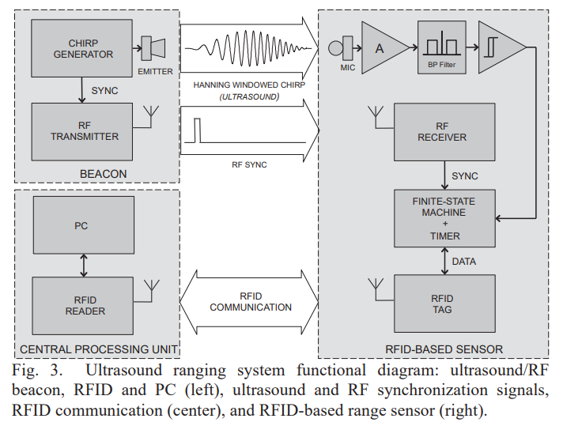
Ranging Technique and System Architecture
System Architecture

Slide 11
System Realization
Central Processing Unit
A dedicated processor or FPGA can also be used, but we are utilizing a PC here. The algorithms are written in MATLAB and they are executed to generate the signals and to store and analyze the data.
Ultrasound and RF beacon
The ultrasound emitter employed is an HT 259, driven by a custom Class AB MOSFET power amplifier. Preliminary tests have shown that this specific model is able to emit sufficiently accurate chirp signals in the desired acoustic band.
RFID-based remote sensor
The ultrasound circuit includes a miniature microphone FG6163, which is a micromachined condenser microphone in a cylindrical shape package, length and diameter 2.6 mm, weight 80 mg, and acoustical receiving window diameter 0.79 mm. The receiving acoustical window is small compared to the used wavelength range (about 8.6-22.9 mm in the 15-40 kHz range, with sound speed in air 343 m/s), ensuring a good approximation of a point-like omnidirectional receiver.

Slide 12
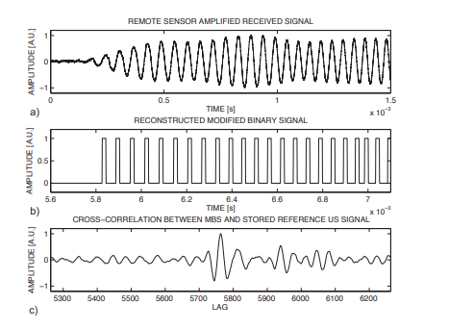
Experimental Results
Cross-correlation

Slide 13

Experimental Results
As for the accuracy and reliability, the lower bound for the time accuracy detection of the time delay is given by Cramer-Rao formula
BT is time-bandwidth product
f₀ is the center frequency
SNR is the signal-to-noise ratio (SNR high enough to have no ambiguity in the peak detection)

Slide 14
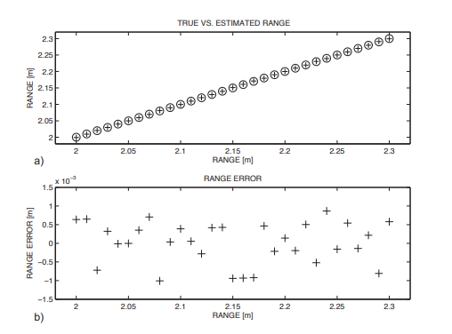
Experimental Results
The experimental ranging results and the errors when the remote sensor is moved along a straight line is shown below

Slide 15
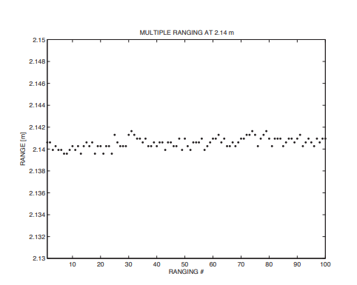
Experimental Results
Multiple ranging at 2.14m is shown below

Slide 16
Conclusion
The technique presented aimed to provide measurements for ranging of a RFID tag using cross-correlation technique with minimal computation and power to the processing unit. At the same time, it also aimed to provide ranging accuracy in the order of millimeters, which is much smaller than the employed ultrasound wavelength.
Experimental results show a ranging accuracy of about ±1.2 mm within a range of 2.30m.
Reasonably low ultrasound frequencies have been used, in order to use commercial and low-cost ultrasound components, still obtaining millimeters ranging accuracy.
The applications of this method can be seen in various fields like IoT smart devices, gestural interfaces, real time tracking of human movements and gaming consoles.

Slide 17
References
[1] L. M. Ni, Y. Liu, Y. C. Lau, and A. P. Patil, “LANDMARC: Indoor Location Sensing Using Active RFID,” Springer Wirel. Networks, vol. 10, no. 6, pp. 701–710, 2004.
[2] N. B. Priyantha, A. Chakraborty, and H. Balakrishnan, “The Cricket location-support system,” in Proceedings of the 6th annual international conference on Mobile computing and networking - MobiCom ’00, 2000, pp. 32–43.
[3] F. Ionescu, R. Carotenuto, and R. Urbani, “3D Localization and Tracking of Objects Using Miniature Microphones,” Wirel. Sens. Netw., vol. 3, no. 5, pp. 147–157, 2011.
[4] D. D. Arumugam, J. D. Griffin, and D. D. Stancil, “Experimental demonstration of complex image theory and application to position measurement,” IEEE Antennas Wirel. Propag. Lett., vol. 10, pp. 282–285, 2011.
[5] A. P. Sample, C. MacOmber, L. T. Jiang, and J. R. Smith, “Optical localization of passive UHF RFID tags with integrated LEDs,” 2012 IEEE Int. Conf. RFID, RFID 2012, pp. 116–123, 2012.
[6] J. Torres-solis, T. H. Falk, and T. Chau, “A review of indoor localization technologies: towards navigational assistance for topographical disorientation,” Ambient Intell., pp. 51–84, 2010.
[7] M. Saad, C. J. Bleakley, T. Ballal, and S. Dobson, “High Accuracy Reference-free Ultrasonic Location Estimation,” IEEE Trans. Instrum. Meas., vol. 61, no. 6, pp. 1561–1570, 2012.
[8] R. Carotenuto and P. Tripodi, “Touchless 3D gestural interface using coded ultrasounds,” in IEEE International Ultrasonics Symposium, IUS, 2012, pp. 146–149.
[9] R. Carotenuto, G. Caliano, and A. S. Savoia, “3D locating system for Augmented Reality glasses using coded ultrasound,” in IEEE International Ultrasonics Symposium, IUS, 2013, pp. 441–444.

Slide 18
Thank you.

